Slide 1
Fully Homomorphic Encryption
Craig Gentry
IBM T.J. Watson Research Center
March 2017
Spring School on Lattice-Based Crypto, Oxford

Slide 2
Homomorphic Encryption at a High Level

Slide 3


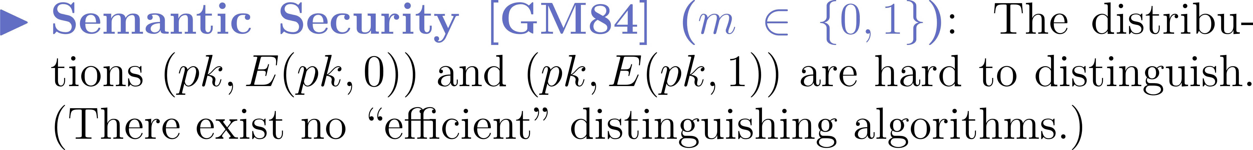
Public Key Encryption (PKE) [DH76,RSA77]
Alice’s
BOX

Slide 4
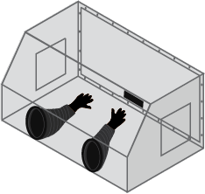
Public-Key Homomorphic Encryption (HE) [RAD78]
GLOVEBOX
Access to messages

Slide 5

Encrypted Cloud Computing
Compute
V[ pk, f, E(pk,m₁), … E(pk,m_{t}) ]
“I want 1) the cloud to process my data 2) even though it is encrypted.
E(pk,m₁) … E(pk,m_{t})
function f
Server (Cloud)
This could be encrypted too.
Alice
Data: m₁, …, m_{t}
Keys: sk, pk
Delegation: Should cost less for Alice to decrypt c than to compute f(m₁, …, m_{t}) herself.
Ciphertext c
f(m₁, …, m_{t})

Slide 6








The Homomorphism in HE

Slide 7
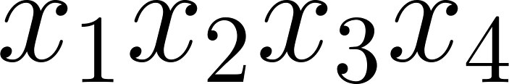
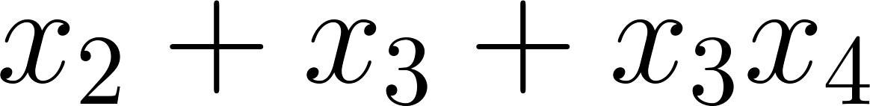



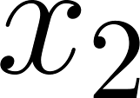
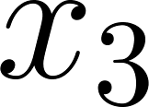
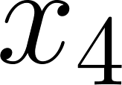
Computation and Arithmetic Circuits

Slide 8
Functionality

Slide 9
Processing (Unencrypted) Data
Forget encryption for a moment…
How does your computer compute a function?
Basically, by working on bits, 1’s and 0’s.
Using bit operations – for example,
AND(b₁,b₂)=1 if b₁=b₂=1; otherwise, equals 0.
AND(b₁,b₂)= b₁×b₂.
XOR(b₁,b₂)=0 if b₁=b₂; equals 1 if b₁≠b₂.
XOR(b₁,b₂)= b₁+b₂ (modulo 2)

Slide 10
Computing General Functions
{ADD,MULT} are Turing-complete (over any ring).
Take any (classically) efficiently computable function.
Express it as a poly-size circuit of ADD and MULT gates.
Circuits vs. Turing machines (about the same):
Circuit size = O(T_{f} log T_{f})
T_{f} = time to compute f on a TM

Slide 11
Let’s Do This Encrypted…
Let b denote a valid encryption of bit b.
Suppose we have a (homomorphic) encryption scheme with public functions E-ADD, E-MULT where:
for any b₁ and b₂.
E-MULT( b₁,b₂ ) = b₁x b₂
E-ADD(b₁,b₂) = b₁+b₂
Then we can AND and XOR encrypted bits.
Proceeding bit-wise, we can compute any function on encrypted data.

Slide 12
Encrypted String Matching
b denotes an encryption of bit b.
Bit-wise encrypted file
Step 1: Match string against subsequences of file
01100111101100100100010001
E-ADD
111011
111011
100010
E-ZeroString(100010) = 0
(not the zero string! not a match!)
E-ZeroString function itself can be computed from basic bit operations.

Slide 13
Encrypted String Matching
b denotes an encryption of bit b.
Bit-wise encrypted file
Step 2: Aggregate info about the subsequences
01100111101100100100010001
111011
111011
111011
111011
111011
111011
111011
111011
0
0
0
0
0
0
1
0
E-OR(00000010…) = 1
(string is in the encrypted file!)
E-OR can also be computed from basic bit operations.

Slide 14
Properties and Limitations

Slide 15
Some Properties
Chosen-ciphertext security: HE is malleable by design, standard CCA security cannot be achieved.
Multi-hop: Can we apply Eval to evaluated ciphertexts?
Usually yes, but not inherently so.
Function privacy: Does V(pk,f,…) hide f?
Even from an adversary that has the secret key?
This can be arranged.
Notes:
Lopez-Alt Tromer Vaikun

Slide 16
FHE Doesn’t Do Obfuscation
Obfuscation:
I give the cloud an “encrypted” program Enc(P).
For any input x, cloud can compute Enc(P)(x) = P(x).
Cloud learns “nothing” about P, except {x_{i},P(x_{i})}.
Difference between obfuscation and FHE:
In FHE, cloud computes Enc(P(x)), and it can’t decrypt to get P(x).
Barak et al: “On the (Im)possibility of Obfuscating Programs”
Certain types of obfuscation are impossible.
Garg et al: “Candidate Indistinguishability Obfuscation and Functional Encryption for All Circuits”
Certain types of obfuscation seem possible (we have schemes).
Notes:
Barak Goldreich Impag Rudich Sahai Vadhan Yang

Slide 17
FHE Doesn’t Do RAM
Circuits vs. RAMs:
Circuits are powerful: Circuit-size ≈ TM complexity.
But random-access machines compute some functions much faster than a TM or circuit (Binary search)
Can’t do “random access” on encrypted data without leaking some information (not surprising)
What we can do:
Oblivious RAM: But this is a very interactive protocol between client and server where server can’t tell what client is computing
Use Obfuscation to do ORAM: Intuitively, obfuscation allows addresses in memory to be revealed “noninteractively”.
Notes:
Gordon Katz Kolesnikov Malkin Raykova Vahlis

Slide 18
FHE Doesn’t Do Multi-Key
Multi-Key FHE
Different clients encrypt data under different FHE keys.
Later, cloud “combines” data encrypted under different keys: Enc_{pk1,…,pkt}(f(m₁,…,m_{t})) ← Eval(pk₁,…pk_{t},f,c₁,…c_{t}).
FHE doesn’t do this “automatically”.
But, now we have a couple of schemes that do this.
Notes:
Lopez-Alt Tromer Vaikun

Slide 19
Pop Quiz! How can HE be secure?

Slide 20
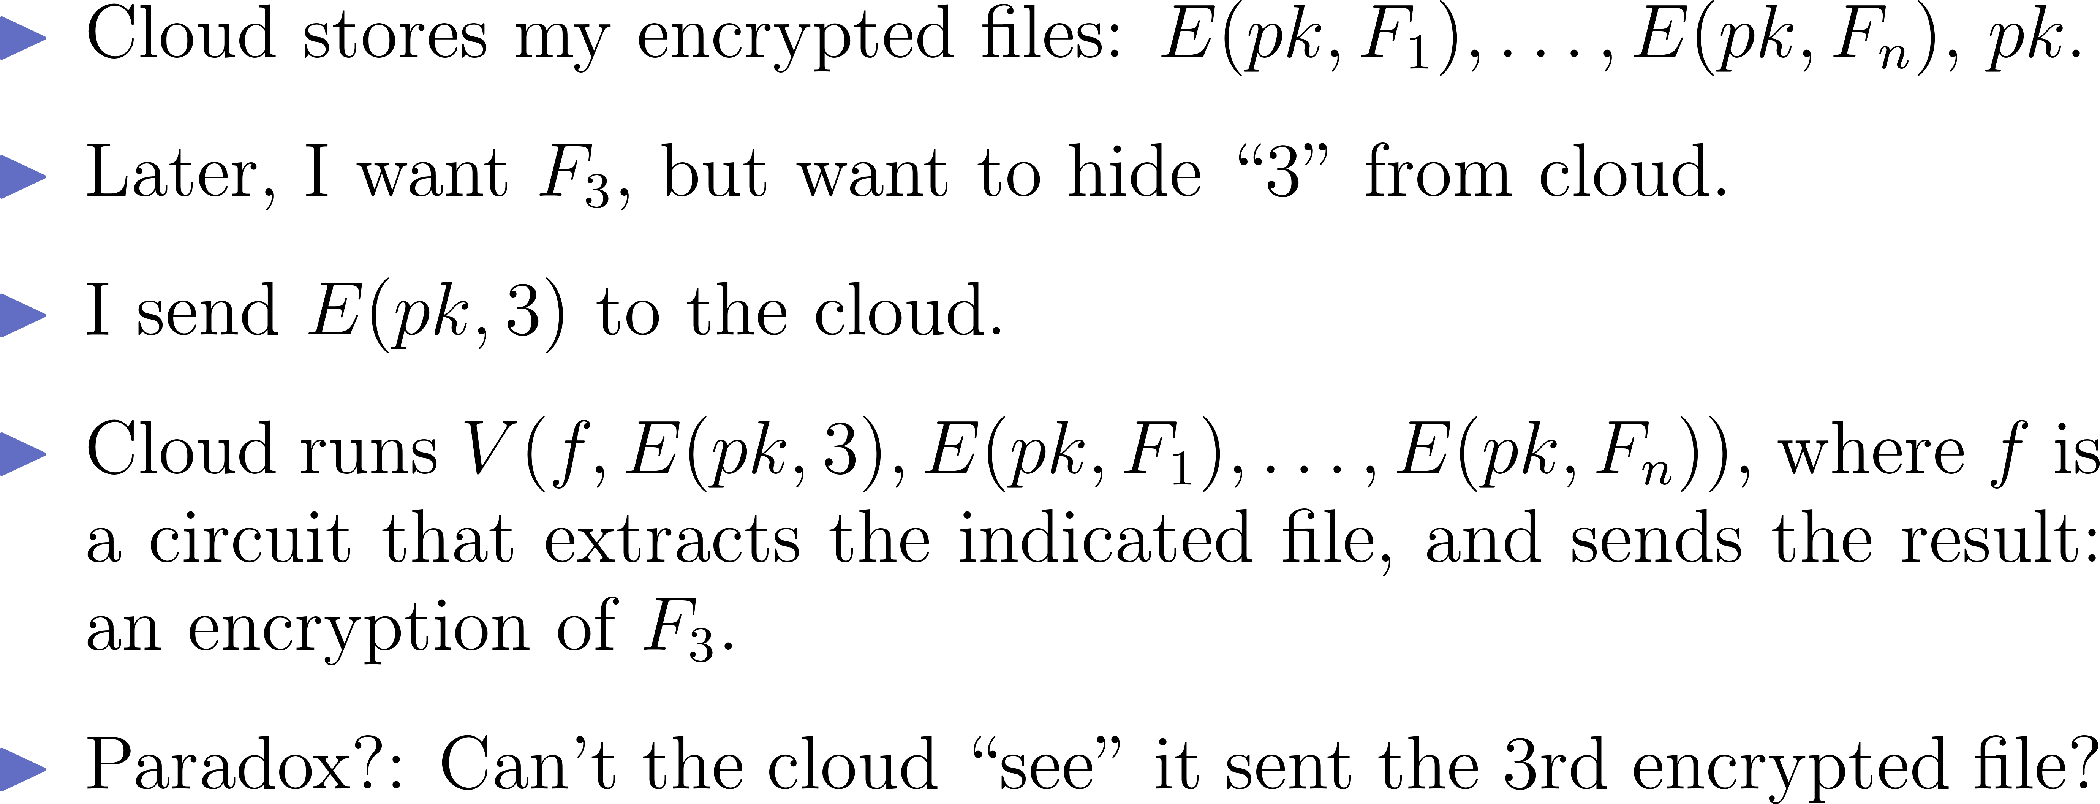
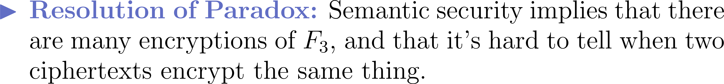
HE Security: A Paradox?

Slide 21
Constructing HE: An Early Attempt

Slide 22
Partially Homomorphic Encryption

Slide 23
Constructing HE: Attempts Using Ring Homomorphisms

Slide 24
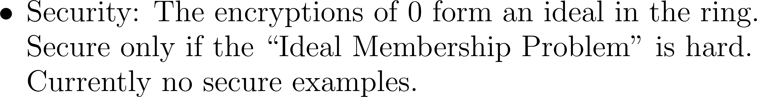
Ring Homomorphism Approach to HE

Slide 25

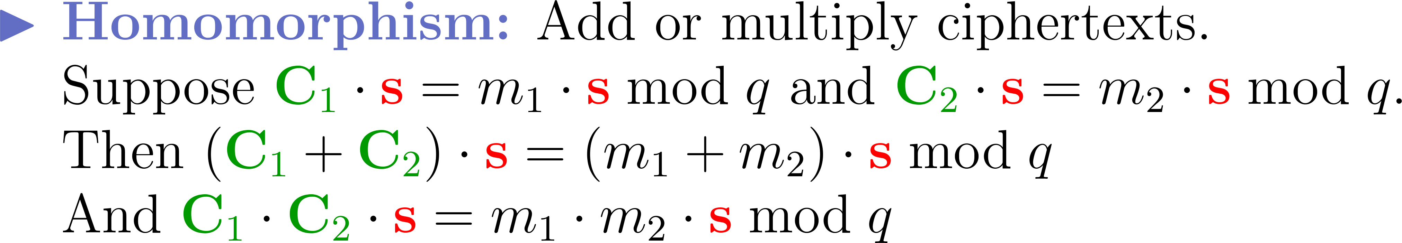
Ring Homomorphisms using Secret Eigenvectors
Ciphertext Matrix
Message Eigenvalue
Secret Key Eigenvector

Slide 26
Ring Homomorphisms using Secret Eigenvectors
Ciphertext Matrix
Message Eigenvalue
Secret Key Eigenvector
Decryption function should be unlearnable
from plaintext/ciphertext pairs (m_{i}, E(m_{i})).
Linear functions are learnable.

Slide 27
Comment on Eigenvector Scheme
Ciphertext Matrix
Message Eigenvalue
Secret Key Eigenvector

Slide 28
Can We Patch the Ring Homomorphism Schemes?

Slide 29
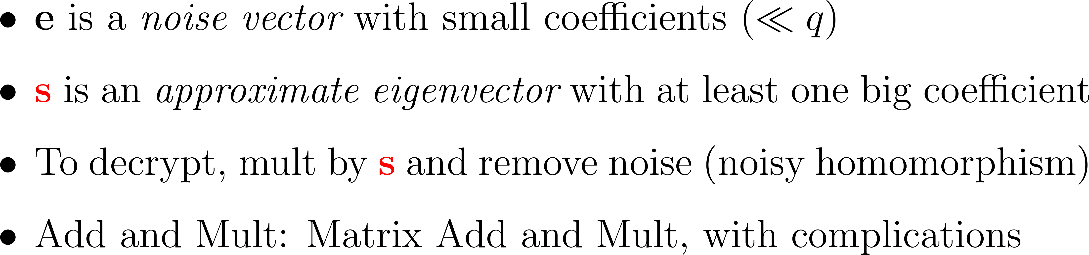
Patch the Eigenvector Scheme with Noise

Slide 30
Bootstrapping: From Bounded to Unbounded Depth [G09]

Slide 31
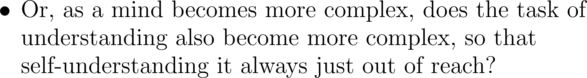
A Digression into Philosophy…

Slide 32
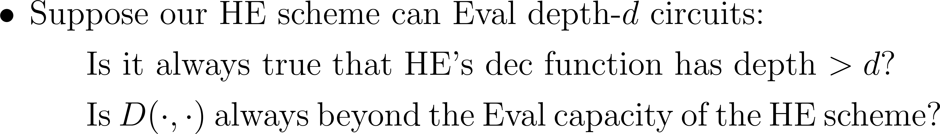
Philosophy Meets Cryptography

Slide 33
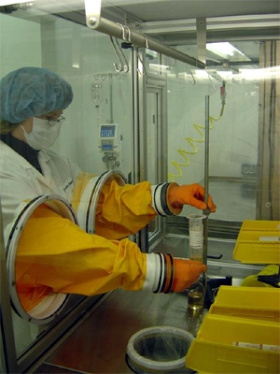
Bootstrapping: Refreshing a Ciphertext
m₁
f
m₂
…
f(m₁, m₂ ,…, m_{t})
m_{t}

Slide 34
Bootstrapping: Refreshing a Ciphertext
c
y
New encryption of y, with less noise.
sk₁
D_{c}
sk₁
sk₂
sk₂
…
c' =
D_{c}(sk)
…
= D(sk,c) = y
sk_{n}
sk_{n}
Homomorphic computation applied only to the “fresh” encryption of sk.

Slide 35
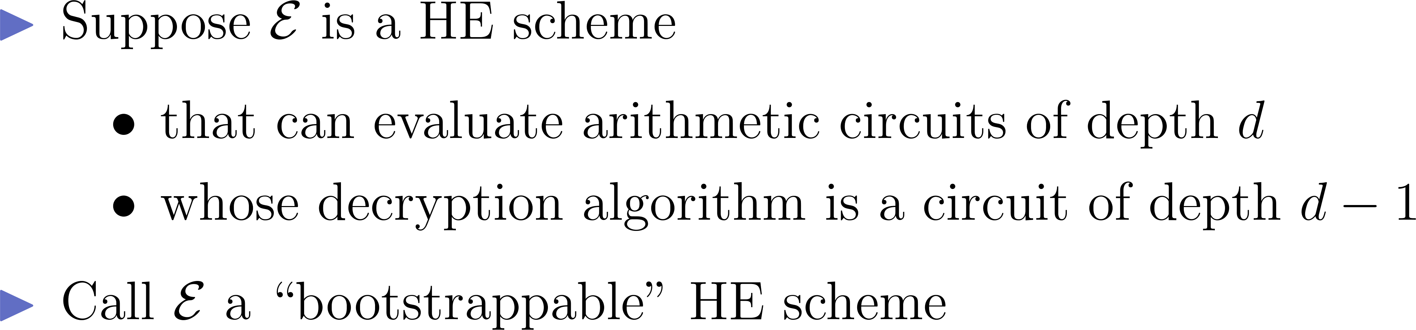
Bootstrapping Theorem (Informal) [G09]

Slide 36
Current Performance / Practicality
Focusing on the HELib (HE Library) open-source implementation by Halevi and Shoup

Slide 37
Usable Homomorphic Encryption
2009-10: Plausibility
[GH’11] A single bit operation takes 30 minutes
2011-2012: “Real Circuits”
[GHS’12] A 30,000-gate in 36 hours
2013-today: Usability
HElib [HS’14]: IBM’s open-source FHE implementation
Basis for “generic” FHE computation
An “assembly language” for FHE
Implements Brakerski-Gentry-Vaikuntanathan (BGV) scheme
Security based on ring LWE (RLWE)
The same 30,000-gate circuit in 4-15 minutes
Notes:
GH: Gentry, Halevi
GHS: Gentry, Halevi, Smart
HS: Halevi, Shoup

Slide 38
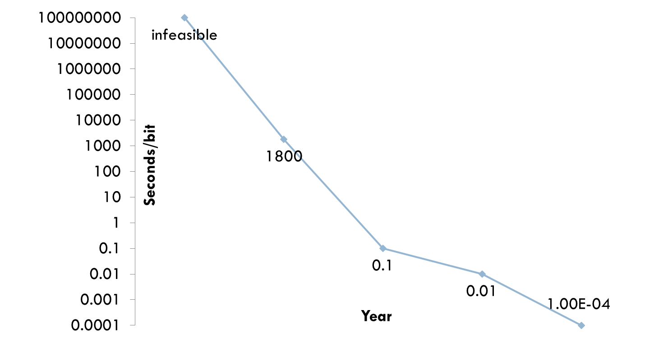
Speed of Computing on Encrypted Data
Moore’s law
Estimated amortized time for computing a single bit operation on encrypted data
2010
2011
2012
2013
2014

Slide 39
HElib Speed Examples
Implementing the “AES-128” circuit
AES is itself a cipher, ~30,000 gates
Processing 100-200 blocks in 4-15 minutes
w/o bootstrapping: 120 blocks in 245 seconds
with bootstrapping: 180 blocks in 1050 seconds
But then you can keep processing the result
Encrypted genome Computations
Comparing two genome sequences with ~100,000 SNPs in 5-10 minutes
Intersection of two encrypted sets, each with ~100,000 elements, in ~5 minutes
Single-thread implementation on small laptop
With parallelization/acceleration, speedup of 2-3 orders of magnitude should be doable

Slide 40
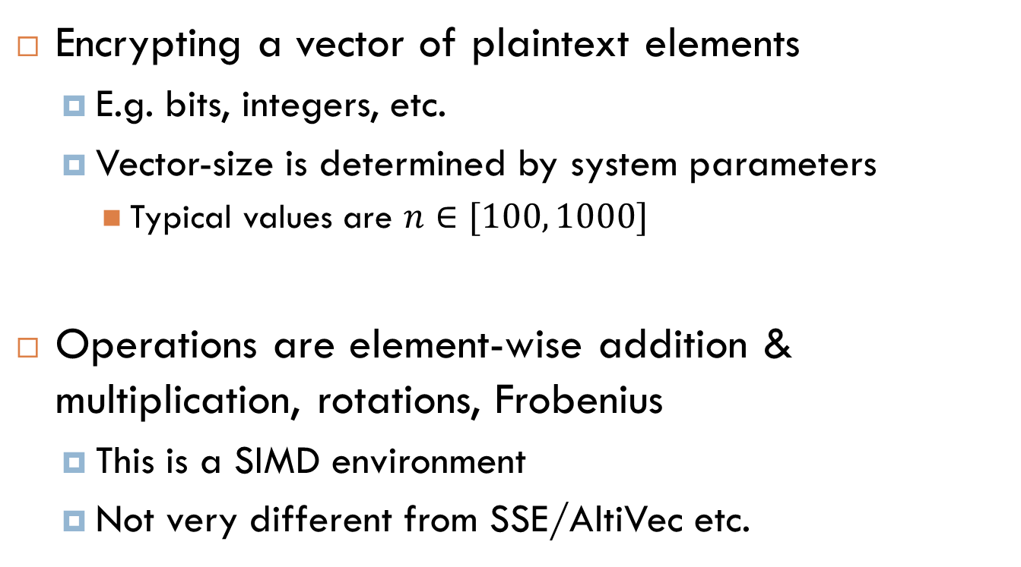
The HElib “platform”

Slide 41
What Next for HElib?
Much work needed before it becomes really usable
Better CRYPTO/math algorithms (as always)
More high-level functionality
Speed: parallelism, accelerators
Usability: better APIs, integration, tools

Slide 42
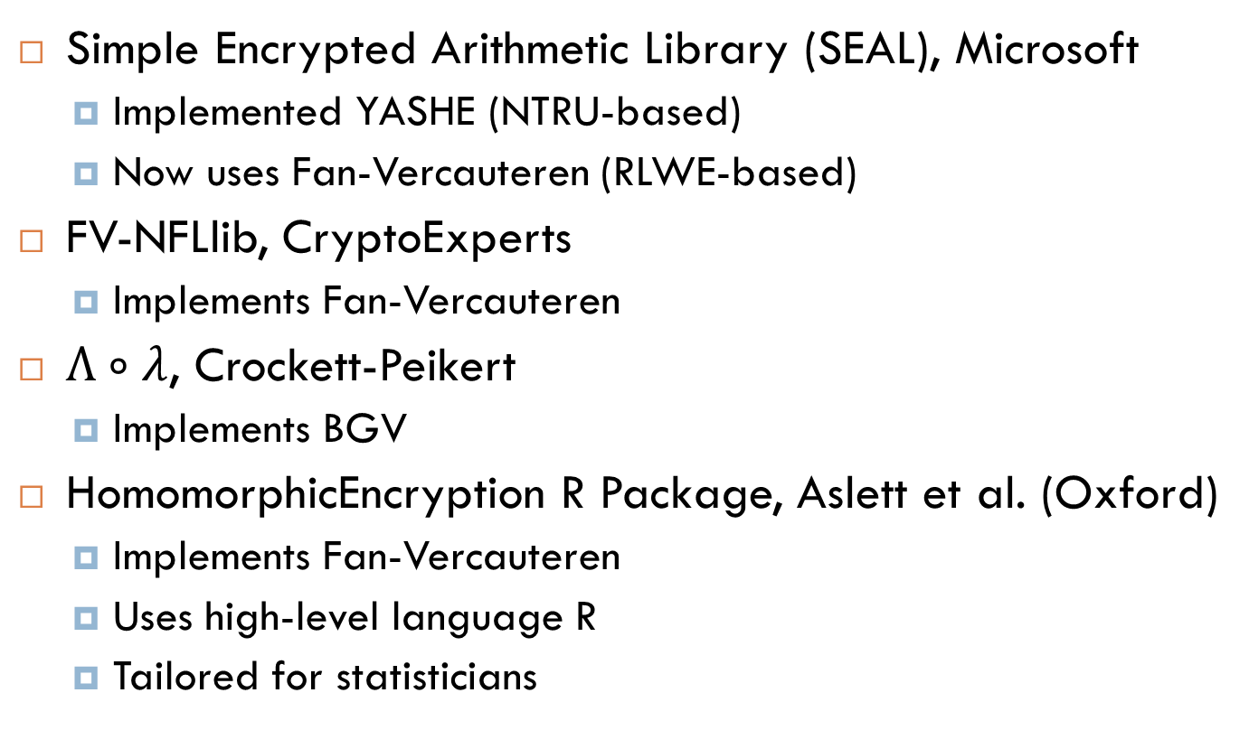
Other Implementations
Simple Encrypted Arithmetic Library (SEAL), Microsoft
Implemented YASHE (NTRU-based)
Now uses Fan-Vercauteren (RLWE-based)
FV-NFLlib, CryptoExperts
Implements Fan-Vercauteren
$Λ∘λ$, Crockett-Peikert
Implements BGV
HomomorphicEncryption R Package, Aslett et al. (Oxford)
Implements Fan-Vercauteren
Uses high-level language R
Tailored for statisticians

Slide 43
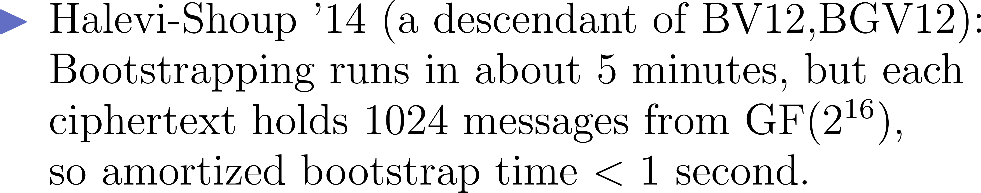
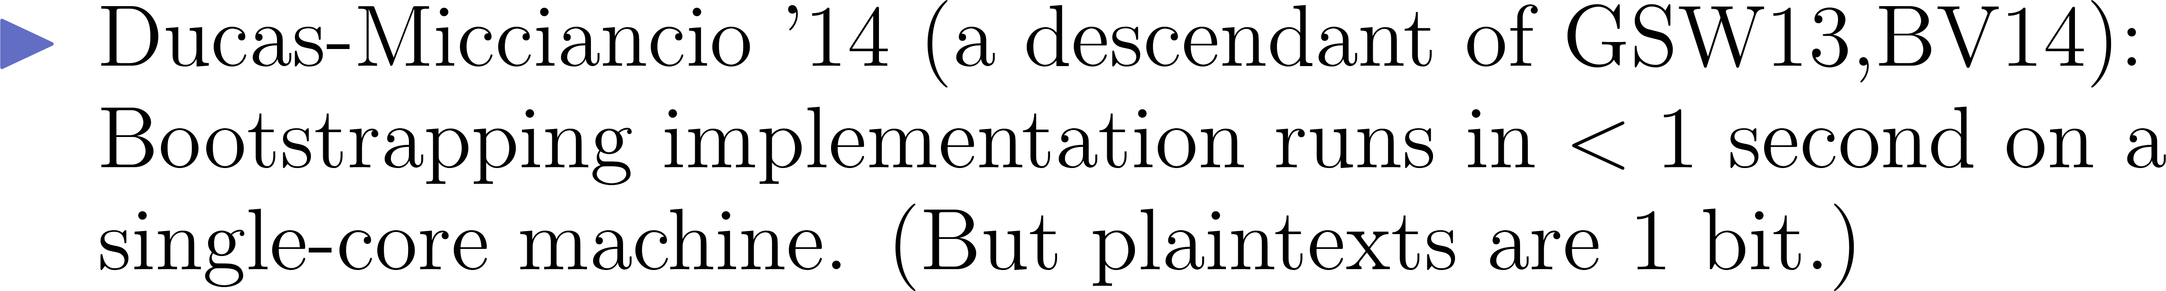
Bootstrapping Getting Faster

Slide 44
Thank You! Questions?
TIME EXPIRED
?
?

